Slide 1



Taking Aim at Special
Claims
Special Claims
North Tampa Housing Development Corporation
SAHMA State Meeting Jacksonville, FL April April 24, 2024

Slide 2

Presenters
North Tampa Housing Development Corporation
Angela Tabakian
Central Contract Specialist NTHDC/CGI Federal
4300 W. Cypress St #300 Tampa, FL
813-554-1282
Carrie Starling
Central Contract Specalist NTHDC/CGI Federal
4300 West Cypress Street, Suite 300
Tampa, FL 33607
813-554-1273
All documents can be downloaded from www.nthdc.org
Submit all Special Claims to: specialclaim@cgifederal.com
2

Slide 3

Topics Covered
North Tampa Housing Development Corporation
Regular Vacancy
Unpaid Rent
Tenant Damage
3

Slide 4
Regular Vacancy Claims
North Tampa Housing Development Corporation

Slide 5


Question?
North Tampa Housing Development Corporation
Are Regular Vacancy Special Claims for?
Reimbursement to tenant for rent.
B. Reimbursement to HUD.
C. Reimbursement to Owner/Agents for rental loss attributed to Vacant units.

Slide 6

What is it and is it Worth Hassle?
North Tampa Housing Development Corporation
Regular Vacancy Special Claims gives reimbursement to Owner/Agents for rental loss attributed to Vacant units.

Slide 7
Regular Vacancy Claim Reviews
North Tampa Housing Development Corporation
When Reviewing Regular Vacancy Special Claims, the most common issues we find are:
Timeliness
Completeness
Security Deposit collection and retention
Waiting List documentation
Claim Calculation
PII not being redacted

Slide 8
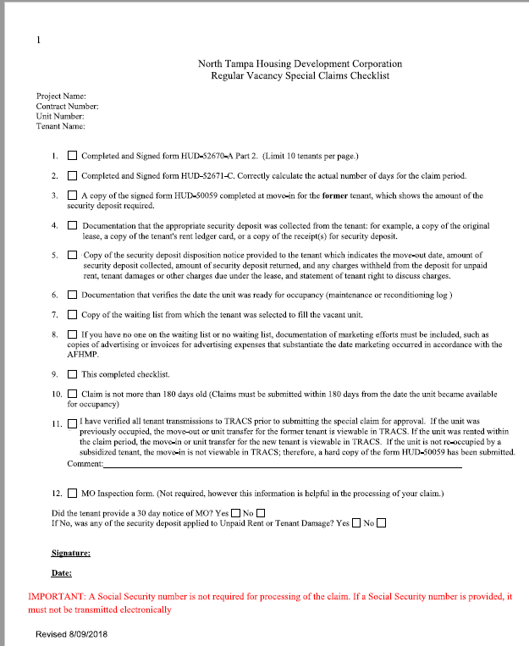
Use the Checklist
North Tampa Housing Development Corporation

Slide 9
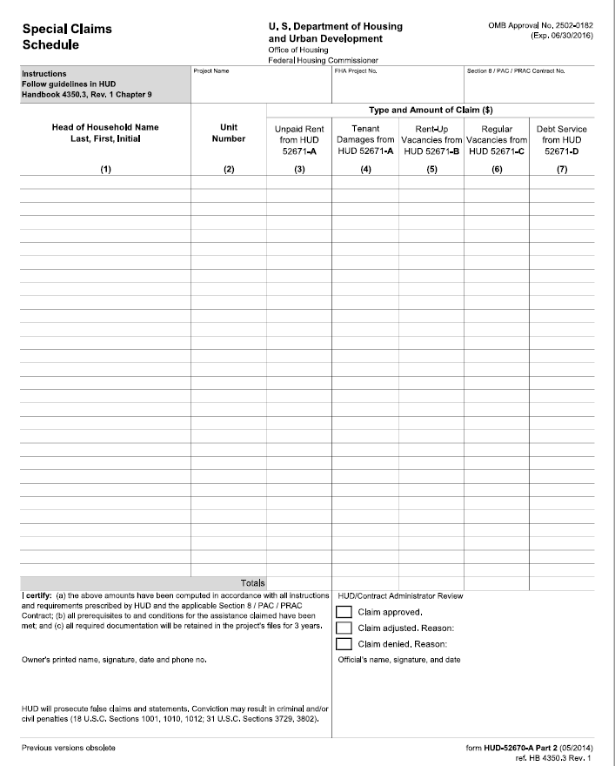
Schedule HUD 52670-A Part 2
North Tampa Housing Development Corporation

Slide 10
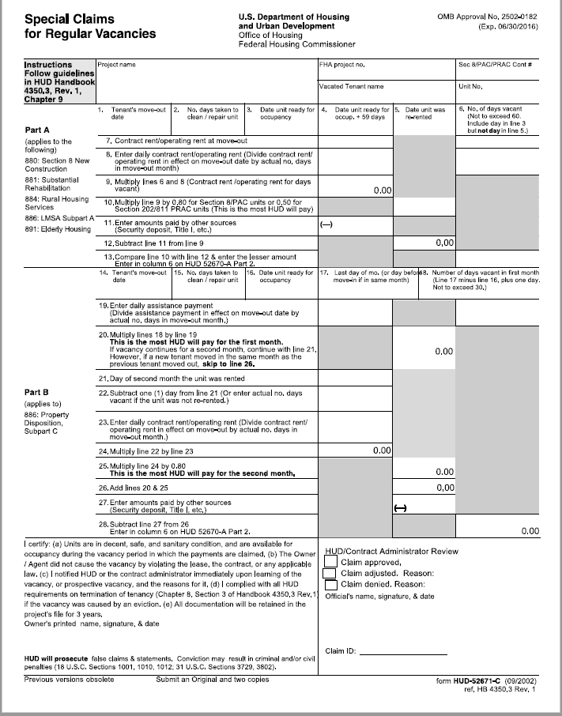
Regular Vacancy HUD 52671-C
North Tampa Housing Development Corporation

Slide 11

Question
Should you include SSN #’s or DOB’s on any of the claim forms?
Yes
No
North Tampa Housing Development Corporation

Slide 12
Question
Should you include the entire waiting list with your submission?
A. Yes
B No
Will your claim be denied for incomplete waiting list?
Yes
No
North Tampa Housing Development Corporation

Slide 13
Claim Submission Tips
Compile your Special Claim as soon as the vacancy occurs. Claims must be submitted within 180 days from the date the unit became available for occupancy.
Use the Special Claim Checklist as a guide to assemble all the documents you need for your Special Claim.
Do not include SSN #’s or DOB’s on any of the claim forms.
All claims must be submitted to:
specialclaim@cgifederal.com
North Tampa Housing Development Corporation

Slide 14
Only submit pages of the waitlist that correlate with the MI tenant. The entire wait list does not need to be submitted.
If the waitlist is several pages long, please indicate on which page the MI tenant is listed.
If it took over 30 days to make the unit ready after MO, an explanation MUST be given.
If the OA does not have the signed 50059, then submit the lease that is signed/dated
by management and tenant.

Slide 15

Unpaid Rent
North Tampa Housing Development Corporation

Slide 16
Question?
North Tampa Housing Development Corporation
Can you submit a special claim for a unit in which the previous tenant was terminated?
Yes
B. No
Can a claim be denied if you submit these items 60 days after MO?
evidence that the security deposit was collected
copy of the certified letter detailing unpaid rent and disposition of the SD
documentation that the matter was turned over to a collection agency

Slide 17
Unpaid Rent Claims
North Tampa Housing Development Corporation
What are Unpaid Rent Claims used for and who can these claims be submitted for?
Allows O/A’s to be reimbursed for any unpaid rent left by the former tenant.
Unpaid Rent Special Claims can be submitted for any tenant residing at the property that received subsidy; with the exception of tenants whose assistance was terminated because of their failure to comply with program requirements.

Slide 18
Unpaid Rent Claim Reviews
North Tampa Housing Development Corporation
When Reviewing Unpaid Rent Special Claims, the most common issues we find are:
Timeliness
Completeness
Security Deposit collection and retention
Waiting List documentation
Calculation and Documentation for Unpaid Rent

Slide 19
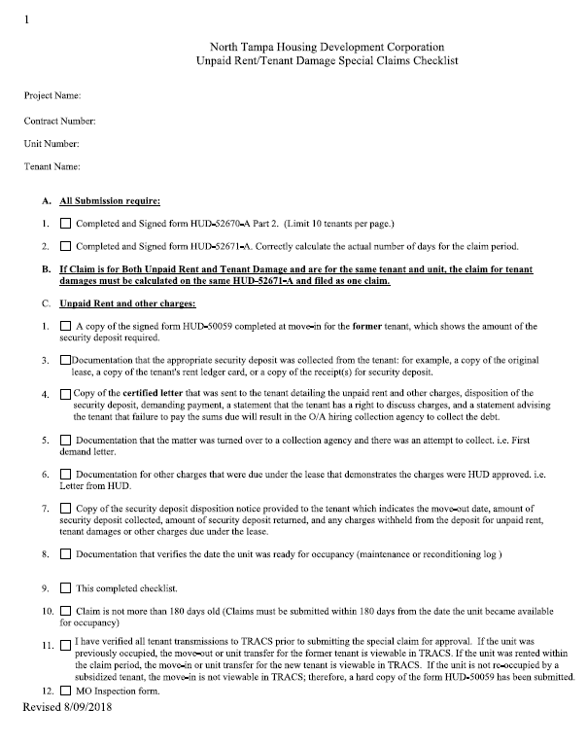
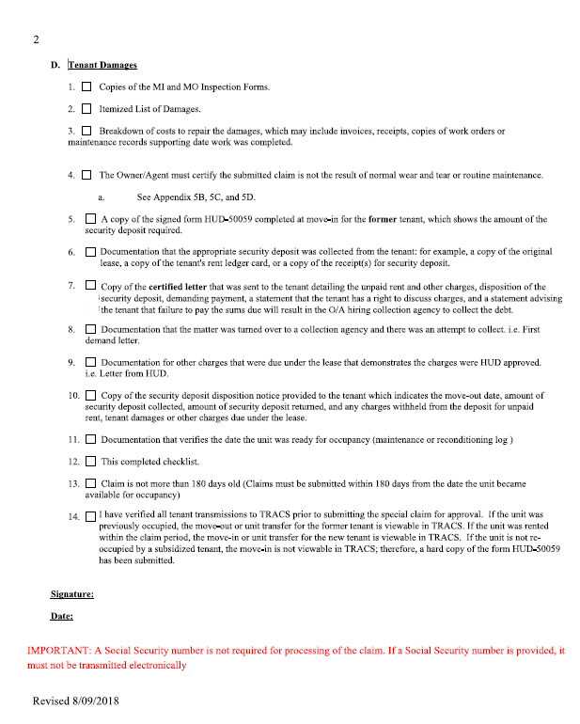
Checklist for Unpaid/Tenant Damages
North Tampa Housing Development Corporation

Slide 20
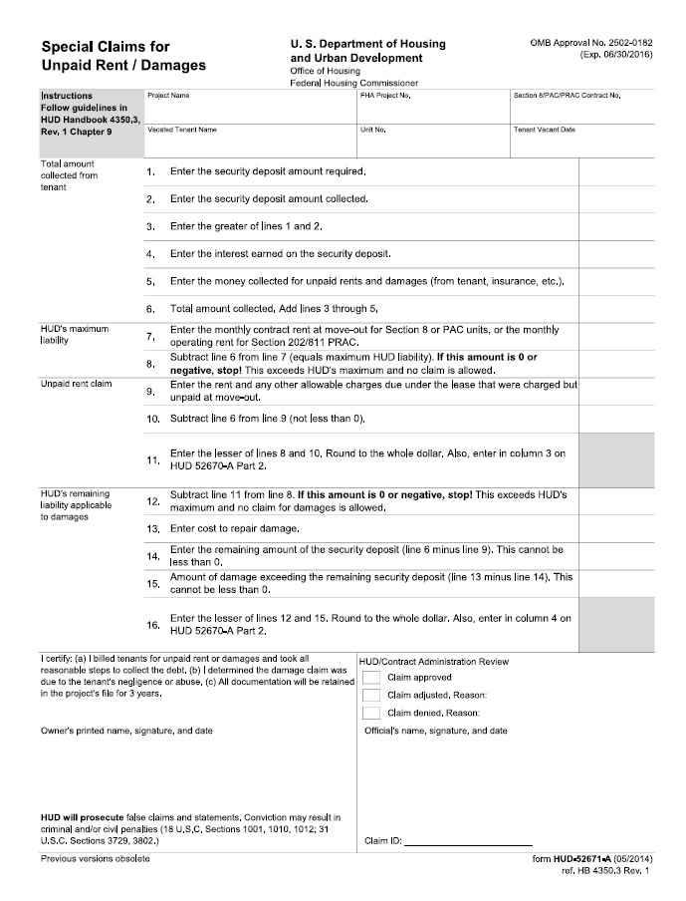
Unpaid/Tenant Damages HUD 52671-A
North Tampa Housing Development Corporation

Slide 21
What CAN be Classified as Unpaid Rent?
North Tampa Housing Development Corporation
Unpaid monthly rent at MO.
Damage amounts billed to tenant that was discovered prior to MO.
Unpaid “Other Charges due Under the Lease” that were HUD approved.
  Failure to return keys
  Late Fees

Slide 22
What CANNOT be Classified as Unpaid Rent?
North Tampa Housing Development Corporation
Legal Fees
Collection Agency Fees
Unpaid utility bills left by the tenant
Cost of photographing unit to prove tenant damage
Any fee that has not been HUD approved
NOTE: 202/8 leases do not allow for charges
for late fees, returned checks or unreturned keys and therefore are not eligible claims.

Slide 23
Unpaid Rent Claim Amount
North Tampa Housing Development Corporation
Total claim amount for both Unpaid rent and tenant damage combined cannot exceed:
  CR-SD + Interest + Amount paid from other sources.
For LMSA, total claim is limited to the SD + remainder of one month’s CR.
For PD, the limit is two months CR – SD

Slide 24
Application of the Security Deposit
North Tampa Housing Development Corporation
The Security Deposit must be applied in the following succession:
  Unpaid Rent
  Tenant Damage
  Regular Vacancy

Slide 25

Another Checklist
North Tampa Housing Development Corporation
HUD 52670-A Part 2 & HUD 52671-A
Copy of the signed MI 50059 for the former tenant.
Evidence that the SD was collected.
Copy of the certified letter detailing unpaid rent and disposition of the SD.
Documentation that the matter was turned over to a collection agency.
Documentation of HUD approval for all other charges.
Maintenance / Reconditioning Log
Waiting List
Advertising Effort if unit was not filled from the waiting list.
NTHDC Checklist.
All Certs must be available in TRACS

Slide 26
Unpaid Rent Submission Tips
North Tampa Housing Development Corporation
Claims must be submitted within 180 days from the date the unit became available for occupancy.
Ensure that the documentation you submit clearly states what the tenant is being charged for and what the exact amount is.
Use the Special Claim Checklist as a guide to assemble all the documents you need for your Special Claim.
Do not include SSN #’s or DOB’s on any of the claim forms.

Slide 27
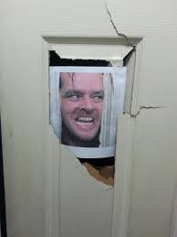
Tenant Damage

Slide 28
Tenant Damage Claims
North Tampa Housing Development Corporation
What are Tenant Damage Claims and who can these claims be submitted for?
Allows O/As to be reimbursed for any damage left by the former tenant that is beyond normal wear and tear.
Tenant Damage Special Claims can be submitted for any tenant residing at the property that received subsidy; with the exception of tenants whose assistance was terminated because of their failure to comply with program requirements.

Slide 29
Tenant Damage Claim Reviews
North Tampa Housing Development Corporation
When Reviewing Unpaid Rent Special Claims, the most common issues we find are:
Timeliness
Completeness
Security Deposit collection and retention
Waiting List documentation
Proration for Life Expectancy
Damage is not above Normal Wear and Tear.

Slide 30
Tenant Damage Claim Amount
North Tampa Housing Development Corporation
Total claim amount for both Unpaid rent and tenant damage combined cannot exceed:
  CR-SD + Interest + Amount paid from other sources.
For LMSA, total claim is limited to the SD + remainder of one month’s CR.
For PD, the limit is two months CR – SD

Slide 31
Application of the Security Deposit
North Tampa Housing Development Corporation
The Security Deposit must be applied in the following succession:
  Unpaid Rent
  Tenant Damage
  Regular Vacancy

Slide 32
Submission Requirements
North Tampa Housing Development Corporation
HUD 52670-A Part 2 & HUD 52671-A
Copies of the MI & MO Inspection Forms
Itemized List of Damages
Breakdown of costs to repair the damages.
O/A must certify that the damage is not the result of normal wear and tear.
Copy of the signed MI 50059 for the former tenant.
Evidence that the SD was collected.
Copy of the certified letter detailing Damage and disposition of the SD.
Documentation that the matter was turned over to a collection agency.
Documentation of HUD approval for all other charges.
Maintenance / Reconditioning Log
Waiting List

Slide 33

Submission Requirements
North Tampa Housing Development Corporation
Advertising Effort if unit was not filled from the waiting list.
NTHDC Checklist.
All Certs must be available in TRACS

Slide 34
Normal Wear & Tear Vs. Tenant Damage
North Tampa Housing Development Corporation
Normal Wear/Tear
Fading, peeling, cracked paint.
Carpet faded, dirty or worn thin from walking.
Rusty metal fixtures.
Dirty or fade blinds.
Nail holes or cracks in the wall.
Small chips in plaster.
Loose grouting and tiles.
Slightly faded wallpaper.
Tenant Damage
Missing Fixtures
Broken windows
Holes, stains, burns in the carpet.
Holes in the sheetrock.
Doors removed from hinges.
Drawings, markings, discoloration on the wall or wallpaper.

Slide 35
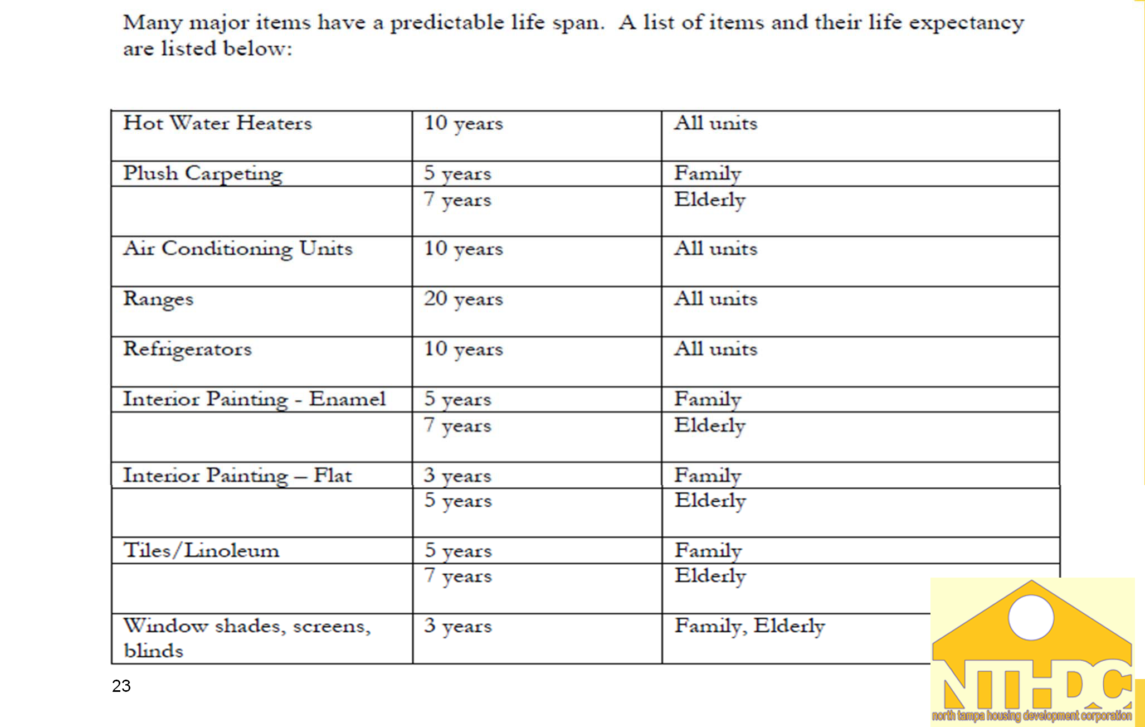
Life Expectancy for Replaceable Items
North Tampa Housing Development Corporation

Slide 36
Tenant Damage Submission Tips
North Tampa Housing Development Corporation
Claims must be submitted within 180 days from the date the unit became available for occupancy.
Ensure that the documentation you submit clearly states what the damage is and the exact cost to repair damage.
Be descriptive when detailing the damage.
Use the Special Claim Checklist as a guide to assemble all the documents you need for your Special Claim.
Do not include SSN #’s or DOB’s on any of the claim forms.

Slide 37
Question
North Tampa Housing Development Corporation
Is the FL8001299XXXXX number required when submitting claim on HAP?
A.Yes
B. No
How many days do you have to submit the Claim on your HAP?
A. 60 days
B. 90 days
C. 120 days

Slide 38
Submitting Claim on Vouchers
North Tampa Housing Development Corporation
Please make sure when implementing the approved claim on the HAP that the Entire Unique Claim ID # FL8001299XXXXX is included.
If not, the HAP will be rejected.

Slide 39


Questions???
North Tampa Housing Development Corporation
28

